Slide 1



NASA Symposium 2015
Pima Community College
April 18, 2015
Team Members
Nicholas Patzke
Gustavo Guerrero

Slide 2
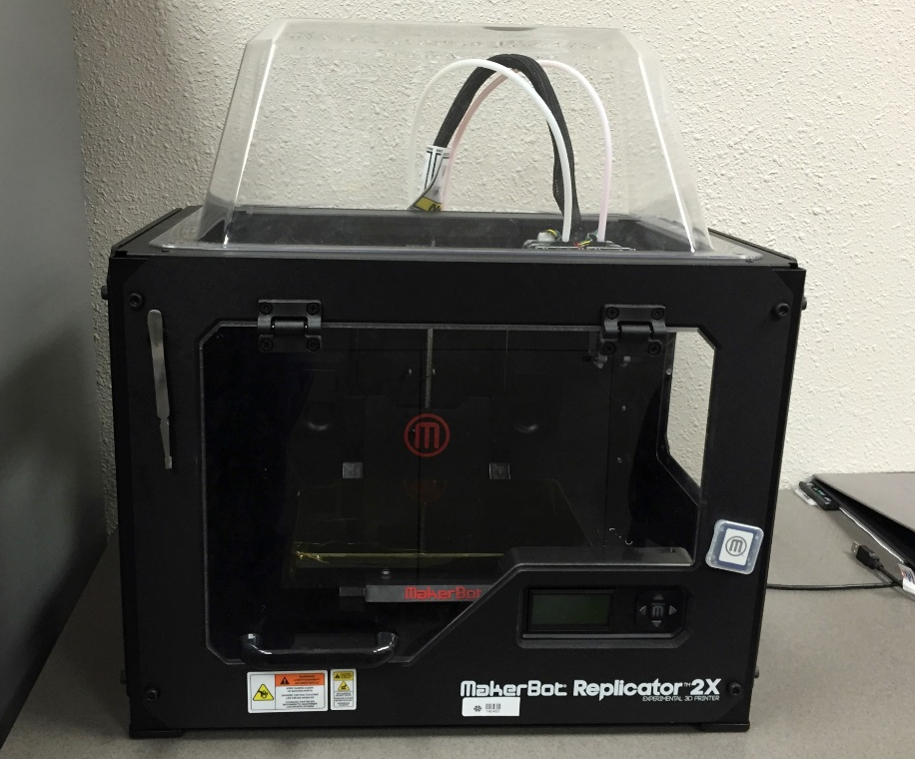
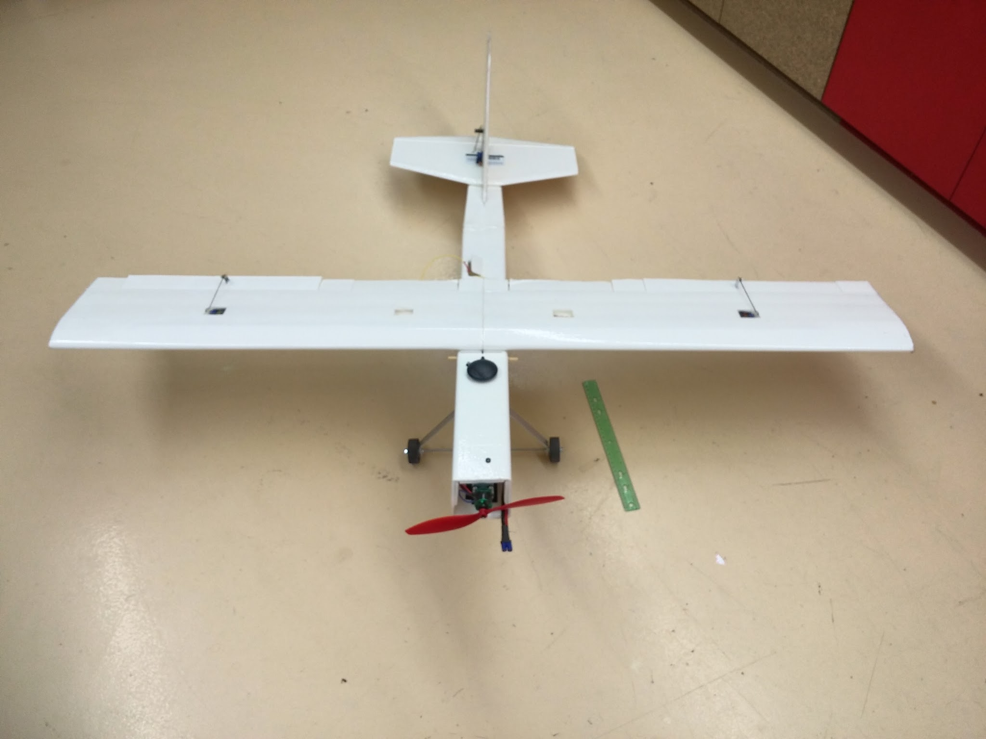
Our Projects
MakerBot Replicator 2X
Fixed Wing UAV

Slide 3
Part 1:
The 3D Printer

Slide 4
Printer Updates
Software
Firmware Update
SailFish 7.7
Acceleration
Deceleration
ReplicatorG 40 - Sailfish
Skeinforge slicing engine
accurate and precise, but complex
Hardware
Bed Plate
Previously Kapton tape
Changed to 8”X10” glass
Smoother surface
Better adhesion
Plastic Slurry
Acetone and ABS mixture
Extruder Upgrades
Plastic feed system
Extruder tensioner

Slide 5
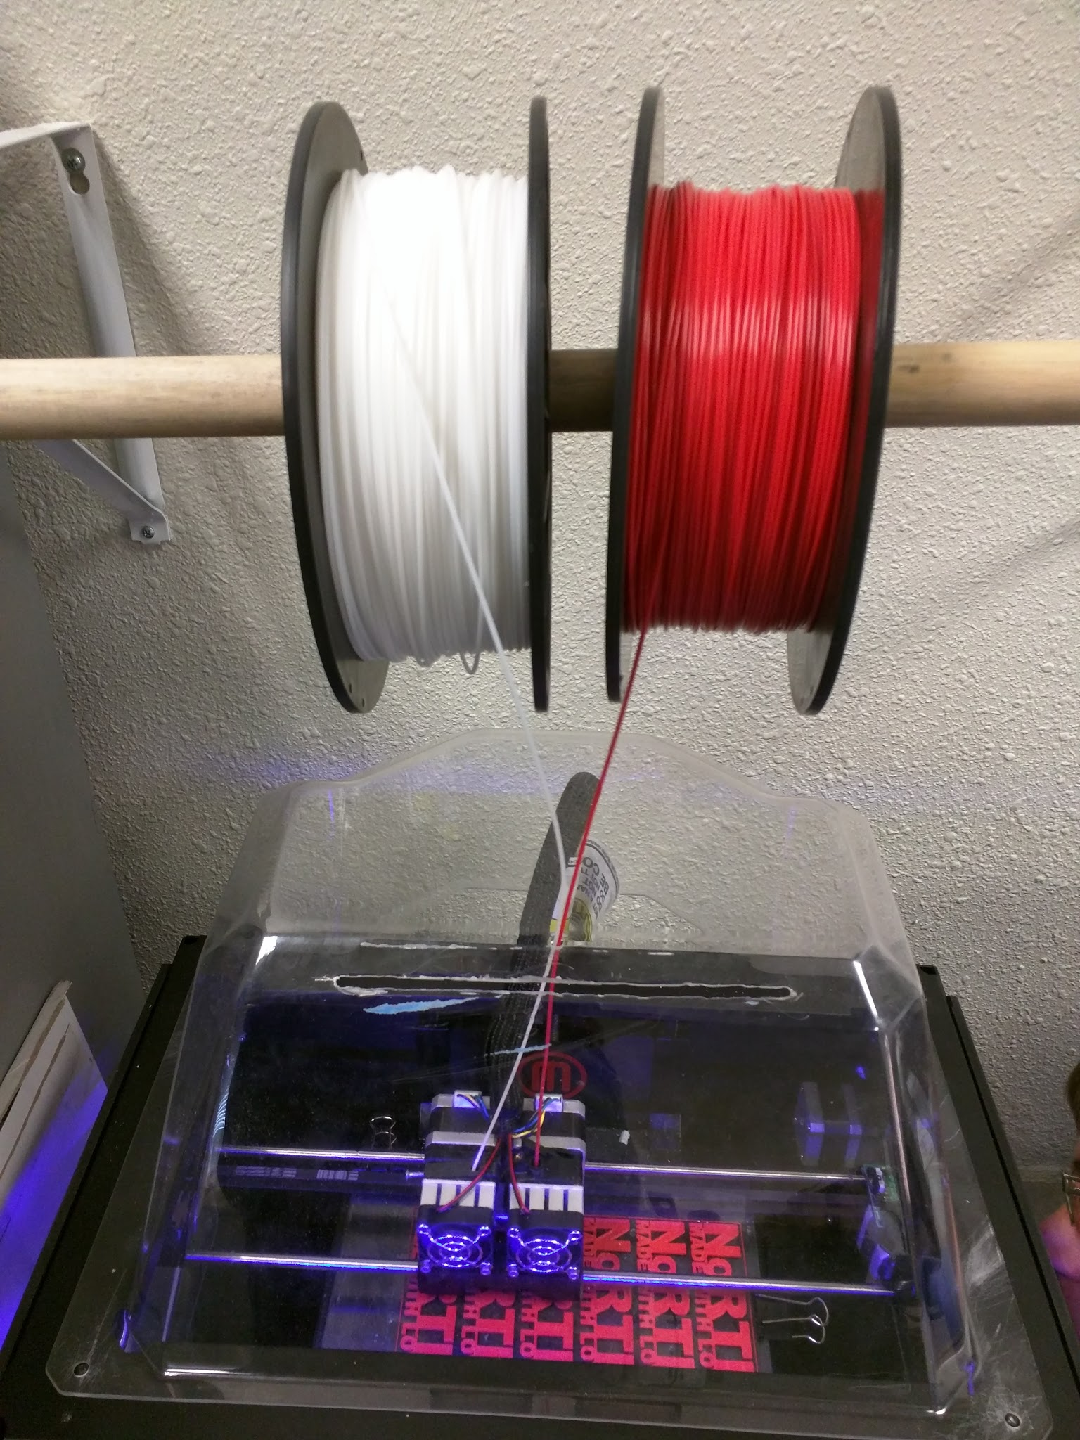
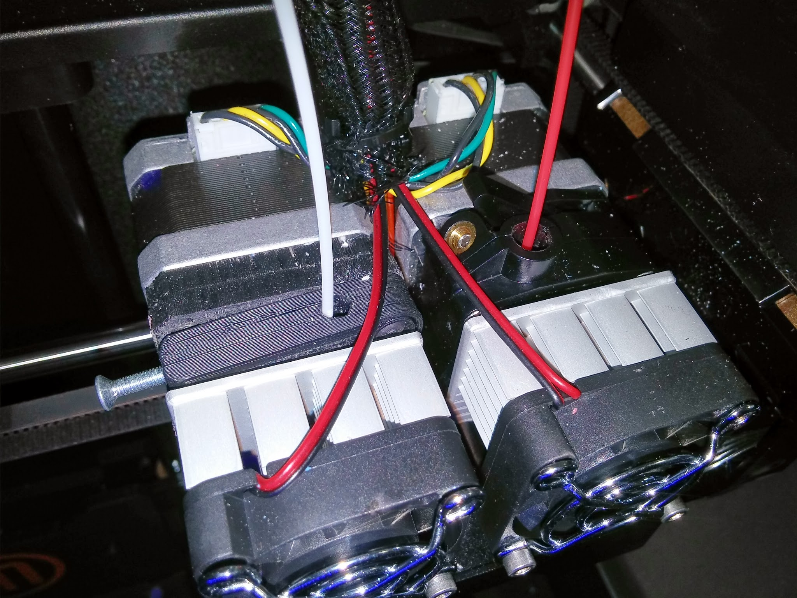
Hardware Photos

Slide 6
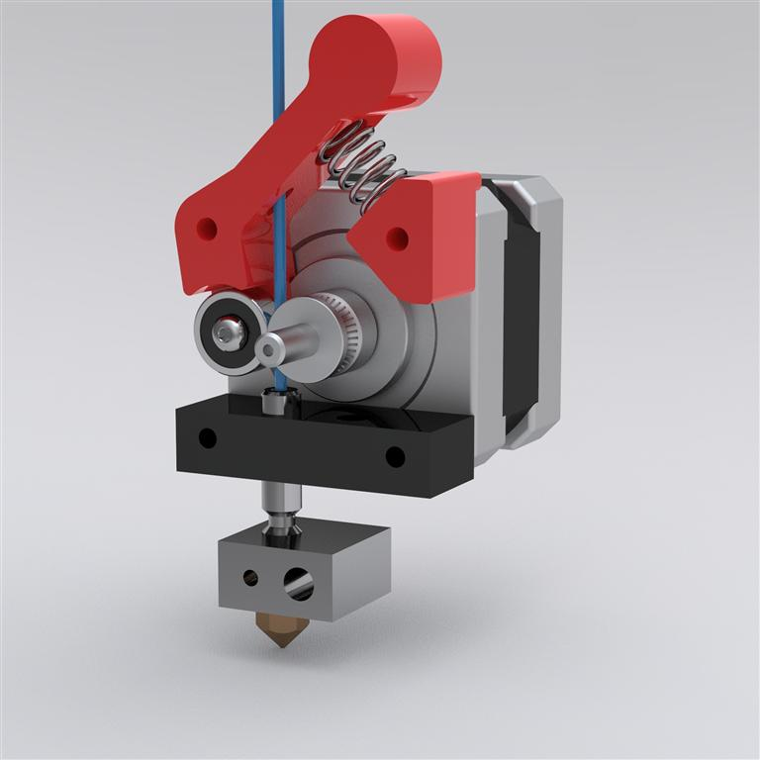

Slide 7
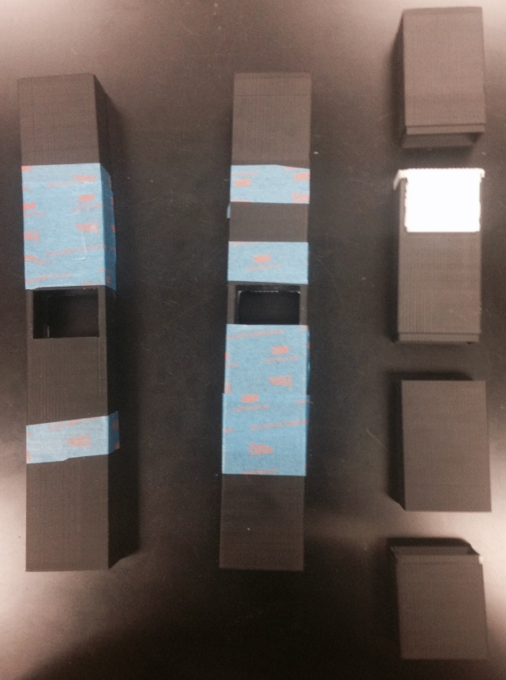
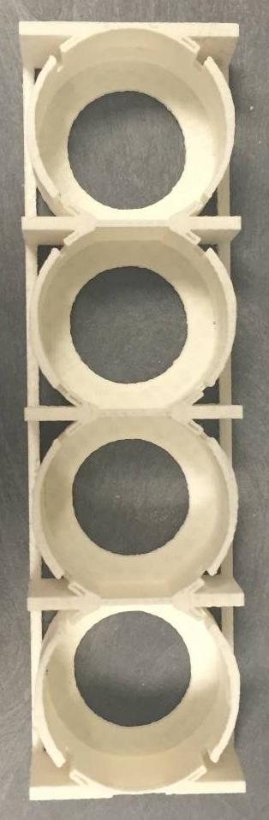
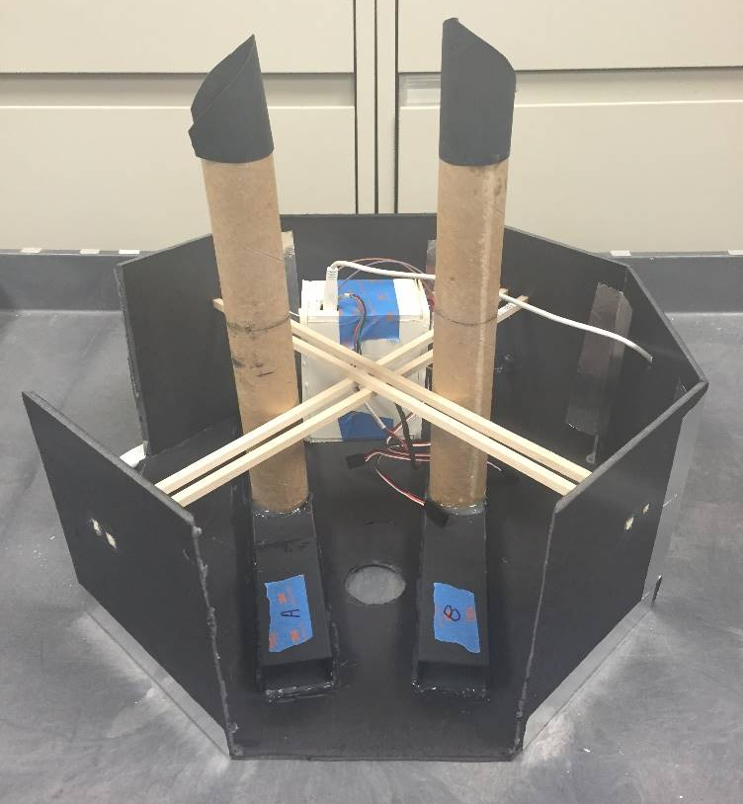
ASCEND Payload Parts
Aerogel Rack
Rack Sliding Container
Mid-Build Interior View

Slide 8
3D Printer Conclusion
Software and hardware updates successful
More reliable printing
Faster and higher quality prints

Slide 9
Acknowledgements
Special thanks to the following
Susan Brew and NASA Space Grant
Jack Crabtree and ANSR
Silvia Kolchens
Mike Sampogna
Mike Tveten

